Slide 1
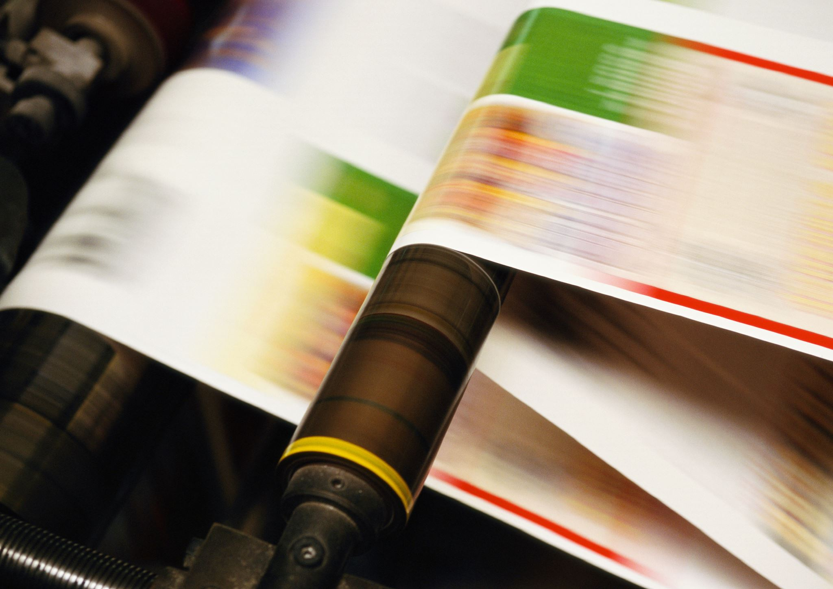
PaintDiffusion –
Sketch-To-Image Converter
Using VAE, GAN, Transformer & Diffusion Models
Course: Generative Artificial Intelligence (PEC)
Guide :
Mrs. Savita Mane
Group Members
202302040004 Nabil Ansari
202302040019 Gourav Sable 202201040015 Vaibhav Shinde

Slide 2
Problem Statement
Translating human-drawn sketches into photorealistic images is challenging due to missing details.

Slide 3
Project Objectives
To Develop 'PaintDiffusion' to convert sketches into realistic images.
To Integrate VAE, GAN, Transformer, Diffusion models.
Train on diverse datasets.
To Evaluate using FID, LPIPS, and human feedback.

Slide 4
Literature Review
Aspect | Paper 1: "A Comparative Analysis Between GAN and Diffusion Models in Image Generation" | Paper 2: "DiffSketching: Sketch Control Image Synthesis with Diffusion Models"
Primary Goal | To theoretically and empirically compare the strengths and weaknesses of Generative Adversarial Networks (GANs) and Diffusion Models (DMs) for general image generation. | To develop a novel method for sketch-guided image synthesis, enabling users to control the output of a diffusion model using free-form line drawings.
Methodology | The paper conducts a review of both architectures, analyzing their training processes, sampling mechanisms, and mathematical foundations. It evaluates them based on metrics like image quality (FID), diversity, and training stability. | It introduces DiffSketching, a two-stage approach. First, an image encoder learns a sketch-like representation. Then, this representation is used to guide a pre-trained diffusion model during the reverse sampling process to generate an image that matches the input sketch.
Key Findings | GANs often produce sharper, more photorealistic images but are notoriously unstable to train and suffer from mode collapse (lack of diversity Diffusion Models offer superior image diversity and training stability but can be computationally expensive due to the iterative sampling process and may sometimes produce slightly blurrier results | The proposed method effectively controls large-scale diffusion models using sketches without needing paired sketch-image data for training the main model It demonstrates strong performance in capturing both the structural and textural details specified by the user's sketch.

Slide 5
Dataset Selection
Dataset: Sketchy Database.
Provides 75,000+ sketch-photo pairs across 125 categories.
Relevance: Direct sketch-photo data.
Scale & Diversity: Ensures generalization.
Quality: Well-curated for training.

Slide 6
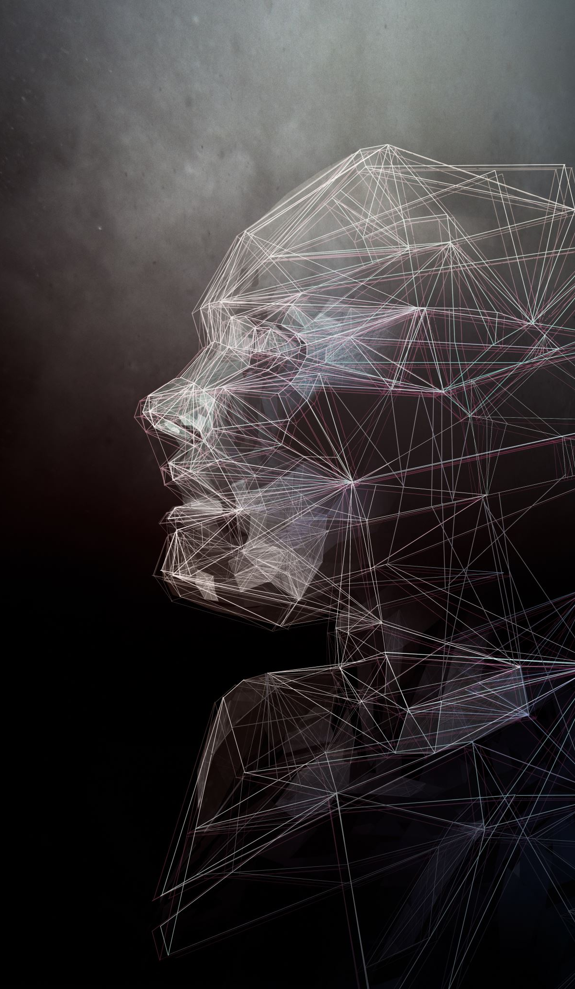
Model Selection & Description
1. VAE: Encodes sketch into latent space.
2. Transformer: Adds contextual understanding.
3. Diffusion Model: Generates images from noise guided by context.
4. GAN: Refines and sharpens final image realism.

Slide 7
Proposed Solution
PaintDiffusion combines multiple generative models:
VAE: Encodes image latent representations.
GAN: Improves realism via adversarial learning.
Transformer: Captures contextual dependencies.
Diffusion: Produces high-quality artistic images.
Web-based interface using FastAPI + HTML/JS frontend.

Slide 8
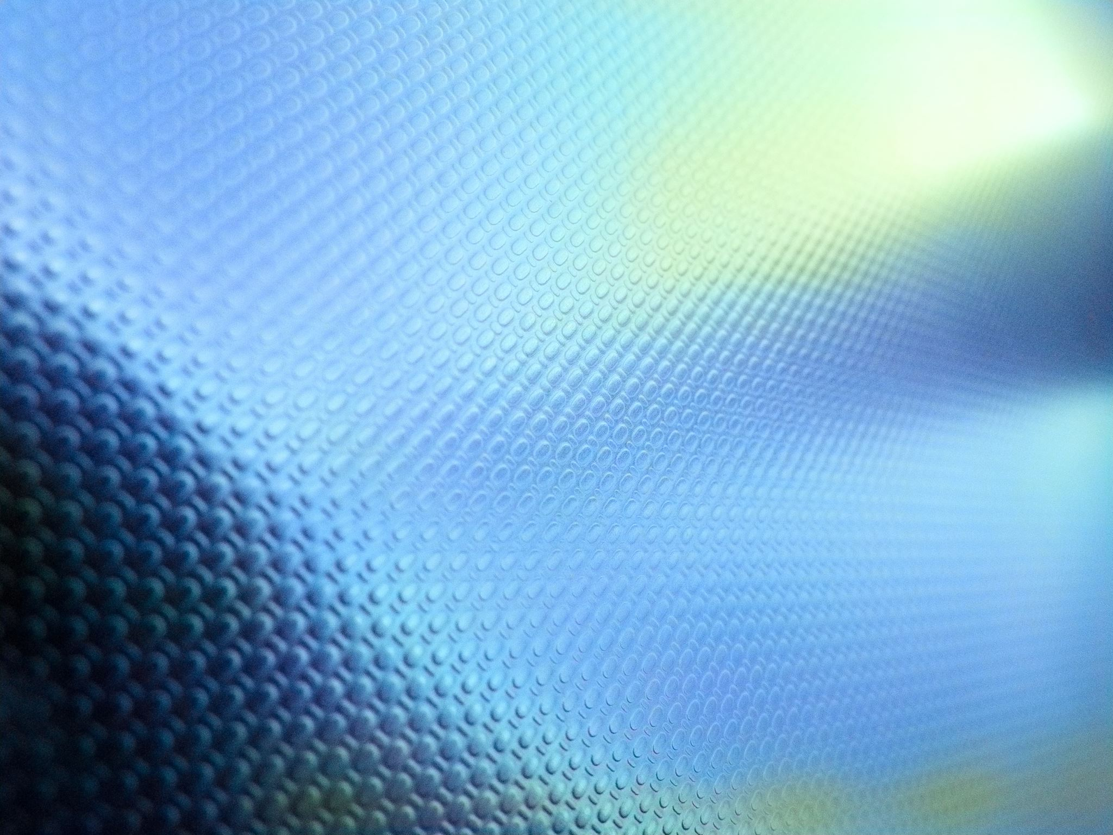
System Architecture
1. User inputs text prompt or sketch.
2. VAE encodes input into latent space.
3. GAN refines latent features for realism.
4. Transformer enhances global context.
5. Diffusion model generates final high-quality image.
6. FastAPI backend serves model; frontend renders images.

Slide 9
Training Loop
1.Data Preprocessing.
2. VAE encodes input into latent space.
3. GAN refines latent features for realism.
4. Transformer enhances global context.
5. Diffusion model generates final high-quality image.
6. Update Model Weights

Slide 10
Technology Stack
• Backend: Python, FastAPI
• Models: PyTorch (VAE, GAN, Transformer, Diffusion)
• Frontend: HTML, JavaScript
• Deployment: Local GPU
• Libraries: Torch, Transformers, Diffusers, CUDA

Slide 11
Implementation Workflow
1. Data preprocessing & latent encoding using VAE.
2. GAN discriminator refines generated samples.
3. Transformer adds contextual creativity.
4. Diffusion model denoises to generate final output.
5. User interacts via web interface.
6. Optimize for CPU/GPU execution.

Slide 12
Mathematical Formulation
VAE Loss: L_VAE = E[log p(x|z)] - β KL(q(z|x) || p(z))
Diffusion Loss: L_DM = E[||ε - εθ(noised x, t, c)||²]
GAN Loss: L_GAN = min_G max_D E[log D(x|c)] + E[log(1 - D(G(z'|c)))]

Slide 13
Expected Results
• High-quality artistic images generated.
• Supports text-to-image and sketch-to-image modes.
• Faster refinement with GPU acceleration.
• Realistic textures, smooth gradients, and artistic styles.

Slide 14
Applications
• Digital Art Creation
• Game Assets Design
• Creative Content Generation
• AI-assisted Illustration Tools
• Virtual Reality & Metaverse Artwork

Slide 15
Future Enhancements
• Fine-tuning on custom art styles.
• Real-time interactive painting assistance.
• Mobile & tablet application support.
• Multi-user collaborative AI painting.
• Integration with VR/AR for immersive experience.

Slide 16
Conclusion
PaintDiffusion demonstrates how hybrid generative AI models
can revolutionize digital painting by assisting artists,
enhancing creativity, and enabling new artistic possibilities.

